Slide 1


EXE101: EXPERIMENTAL ENTREPRENEURSHIP
Source: Y Combinator, 2019

Slide 2


WEEK 6: BUILDING PRODUCT

Slide 3

Learning Objectives
By the end of this lesson, you will be able to …
build the right product and the reasonable business model
plan an MVP
build products users love
build product, talk to users, and grow

Slide 4


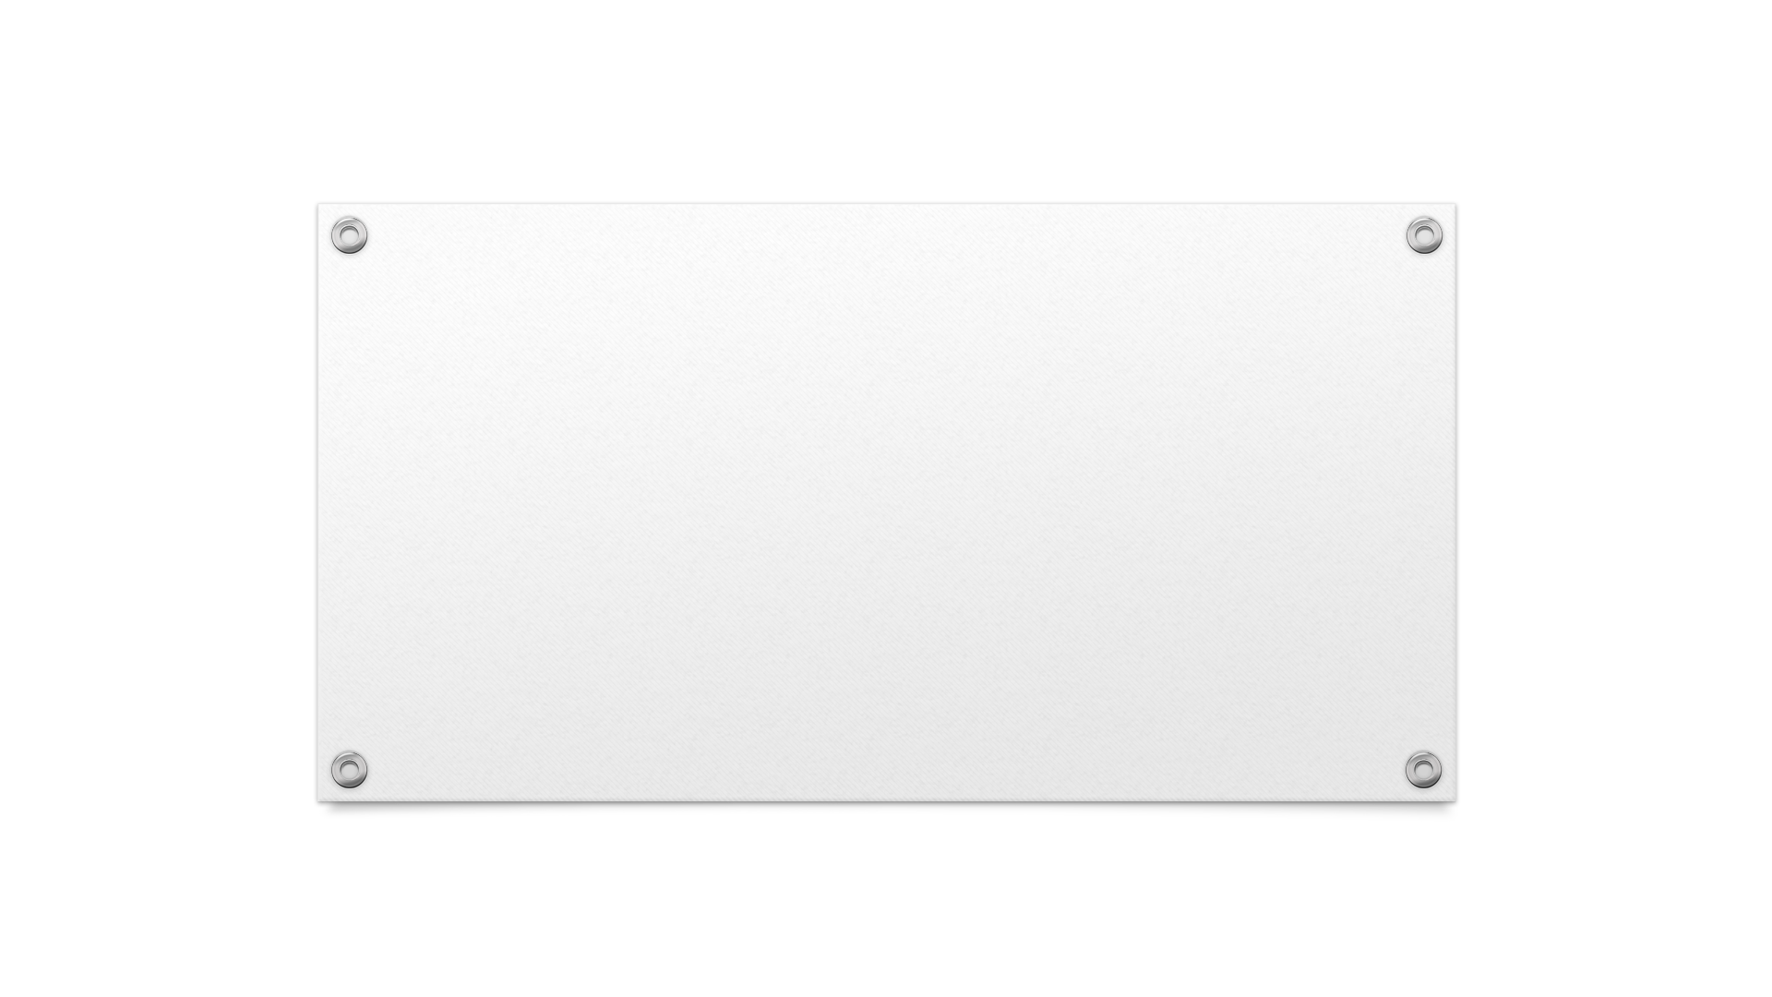
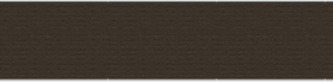
How to plan an MVP

Slide 5

Introduction to MVP
A Minimum Viable Product (MVP) is a version of a new product with only essential features to solve a core problem and satisfy early adopters.
To quickly test and validate a product idea with minimal resources.
Key Concepts:
Lean Startup: MVP is part of the lean startup methodology, focusing on learning and reducing wasted effort.
Iterative Development: MVP is part of a continuous process of iteration and improvement based on user feedback.
(Michael Seibel, 2023)

Slide 6


Benefits of MVP
Fast feedback: Quickly gather user feedback to understand their needs and preferences.
Cost-effective: Reduce development costs by building only essential features first.
Early validation: Validate your product idea before investing heavily in full-scale development.
(Michael Seibel, 2023)

Slide 7

Planning an MVP
Identify Core Problem: Focus on solving a specific, significant problem for your target audience.
Steps:
Market research: Analyze existing solutions and identify gaps.
User research: Conduct surveys, interviews, and focus groups to understand user pain points.
Define problem statement: Clearly articulate the problem in one sentence.
(Spdload, 2024)

Slide 8


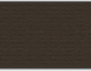
Planning an MVP
Define success criteria: establish clear metrics to determine if the MVP is successful.
Steps:
Identify key metrics: Determine what success looks like. Examples include user engagement, retention rate, and conversion rate.
Set measurable goals: Define specific, quantifiable targets for each metric.
Track progress: Use analytics tools to monitor performance against these goals.
(Spdload, 2024)

Slide 9
Planning an MVP
Build simplest version: focus on essential features that address the core problem.
Steps:
Prioritize features: List all potential features and prioritize based on user needs and feedback.
Develop core features: Build only the most critical features necessary to solve the core problem.
Ensure usability: Make sure the MVP is user-friendly and functional, even if it's basic.
(Spdload, 2024)

Slide 10
MVP Testing
Usability testing: Observe users as they interact with the MVP to identify any usability issues.
Customer interviews: Conduct interviews with early adopters to gather qualitative feedback.
Surveys: Use online surveys to collect quantitative data on user satisfaction and experience.
(Rootquotient, 2024)

Slide 11


Iteration
Process: Use feedback to iteratively improve the MVP.
Steps:
Collect feedback: Gather data from usability tests, interviews, and surveys.
Analyze feedback: Identify common issues, suggestions, and areas for improvement.
Prioritize changes: Determine which changes will have the most significant impact.
Implement changes: Develop and integrate improvements based on feedback.
Test again: Re-test the updated MVP to ensure improvements are effective.
(Rootquotient, 2024)

Slide 12

How to build products users love

Slide 13
First Impressions Matter
Make the login page or first interaction memorable and delightful
Use clear and concise language
Use visually appealing design elements
Make it easy to get started
(Altman, 2024)

Slide 14
First Impressions Matter
Set the tone for the user's experience
Show users what they can expect from your product
Create a sense of excitement and anticipation
Build trust and credibility
(Altman, 2024)

Slide 15
Emotional Connection
Understand the emotions of your users
Identify their pain points and motivations
Empathize with their struggles and desires
Recognize their emotional triggers
(Altman, 2024)

Slide 16
Emotional Connection
Design your product to cater to those emotions
Create a sense of belonging or community
Provide a sense of accomplishment or pride
Offer a sense of relief or comfort
(Altman, 2024)

Slide 17
Support-Driven Development
Have your team do customer support to understand the user's perspective
Engineers, designers, and product managers should all participate in support
This helps to build empathy and understanding of user needs
It also helps to identify areas for improvement in the product
Build empathy and understanding of user needs
By doing support, team members can see firsthand the challenges users face
This helps to inform product decisions and prioritize features
It also helps to create a culture of customer-centricity within the organization
(Altman, 2024)

Slide 18



User Feedback
Collect feedback through various channels
Surveys, email, social media, and in-app feedback
Analyze and prioritize feedback
Identify common themes and patterns
Prioritize feedback based on user impact and feasibility
Close the loop with users
Respond to feedback and show users you're listening
Implement changes and notify users of updates
(Altman, 2024)

Slide 19

Focus on Churn
"Acquiring new customers is expensive, and it's often more cost-effective to retain existing ones. By reducing churn, you can increase customer lifetime value and build a loyal customer base." - Forbes

Slide 20

Remarkability
Create a remarkable experience: Focus on building loyalty with your current customers, as they are the key to sustaining growth.
Treat current clients better than prospects: Never treat a potential client better than you treat a current client, as this can lead to feelings of neglect and dissatisfaction.
Read your customer's minds: The customer determines what is remarkable, so strive to understand their needs and expectations to deliver a unique and memorable experience.
Close the back door: Focus on retaining existing customers, as acquiring new ones can be expensive and time-consuming.
Deliver a remarkable customer experience: This is not a one-time event, but rather a culture that needs to be developed and prioritized to achieve sustainable growth.
Don't overlook gold reserves in your backyard: Focus on the opportunities you already have with your current customers, rather than constantly chasing new business.
(Altman, 2024)

Slide 21







Humility and Manners
Treat others the way you want to be treated
Say please and thank you
Admit when you're wrong
Be humble and open to feedback
Use good manners in all interactions
Show empathy and understanding
(Altman, 2024)

Slide 22



Remote Work
Practice good meeting etiquette: Ensure all remote calls have cameras on to keep everyone alert and engaged.
Experiment with what makes you most productive: Find your optimal work environment and schedule to maximize productivity.
Prioritize documentation and clear communication: Clearly document tasks and communicate effectively to avoid misunderstandings.
(Altman, 2024)

Slide 23

Remote Work
Create boundaries between work and life: Establish a clear separation between work and personal life to maintain a healthy work-life balance.
Make yourself visible at work: Regularly check-in with your team and manager to ensure everyone is aware of your progress and availability.
Schedule time for socializing: Make time for social interactions to combat loneliness and isolation.
(Altman, 2024)

Slide 24

Remote Work
Connect with your teammates: Build strong relationships with your team members to foster a sense of community and collaboration.
Do postmortems on key projects: Conduct retrospectives to identify areas for improvement and implement changes.
Build in accountability: Establish clear goals and expectations to ensure everyone is held accountable for their work.
(Altman, 2024)

Slide 25
Remote Work
Define your and the team's responsibilities: Clearly outline roles and responsibilities to avoid confusion and overlapping work.
Focus on your health: Prioritize your physical and mental well-being to maintain a healthy and productive remote work environment.
(Altman, 2024)

Slide 26
Building product, talking to users, and growing

Slide 27
The importance of building a great product
User Loves
Growth and retention
A great product is one that users love and find indispensable. It solves a significant problem and provides real value.
A high-quality product drives user growth and retention. When users love a product, they not only stick around but also become advocates, driving organic growth through word-of-mouth.
(Altman, 2024)

Slide 28




Understanding your users
Conduct thorough user research to deeply understand their needs, pain points, and behaviors.
Develop empathy for your users to create solutions that resonate with them.
Gather actionable insights that inform product decisions and feature prioritization.
(Altman, 2024)

Slide 29
Building the product
Building the product should start with an MVP to test and validate the core idea quickly. Focus on developing essential features that solve the main problem, allowing for a faster launch and iterative improvement based on user feedback.
Ideation
Core feature identification
MVP development
(Altman, 2024)
User testing

Slide 30

Iterative development and feedback
Develop
Test
Gather feedback
Analyze
An iterative development approach allows for continuous product improvement based on real user feedback.
Improve.
(Altman, 2024)

Slide 31

Talking to users
Engage with users regularly to understand their experiences and gather insights.
Use both qualitative and quantitative methods for comprehensive feedback.
(Altman, 2024)

Slide 32




Growth Strategies
Focus on organic growth through user referrals and word of mouth.
Create a product that users love so much they naturally recommend it to others.
Invest in scalable growth channels like SEO, content marketing, and social media advertising.
Monitor the effectiveness of each channel and optimize for better performance
(Altman, 2024)

Slide 33
Metrics and KPIs
USER ACQUISITION
USER RETENTION
USER ENGAGEMENT
CONVERSION RATE
(Altman, 2024)

Slide 34

Fundraising Tips
Build a great product: focus on creating a compelling product first; a strong product can attract investors naturally.
Clear vision and growth potential:
Be clear about your vision and the potential for growth when pitching to investors.
Highlight how your product solves a significant problem and the size of the market opportunity.
Preparation and pitching:
Prepare a solid pitch deck that covers key aspects such as the problem, solution, market size, business model, traction, and team.
Practice your pitch to ensure clarity and confidence.
(Altman, 2024)

Slide 35

Common mistakes to avoid
Building without validating
Ignoring user feedback
Overcomplicating the product
Lack of focus on growth
(Altman, 2024)

Slide 36
KEY TAKEAWAYS
Focusing on solving a significant problem.
Building only essential features.
Gathering feedback and improve continuously.
Setting clear, measurable goals.
Solving real problems and prioritize ease of use.
Regularly gather feedback.
Building a passionate and skilled team.
Focusing on organic growth and scalable channels.
Tracking user acquisition, retention, and engagement.
Building a great product and articulate a clear vision.

Slide 37

Q&A

Slide 38
Y Combinator. (n.d.). How to plan an MVP. Retrieved from YC
Altman, S. (n.d.). Lecture 7: How to Build Products Users Love. Startup Class. Retrieved from Lecture 7
Altman, S. (n.d.). Lecture 4: Building Product, Talking to Users, and Growing. Startup Class. Retrieved from Lecture 4
Product School. (n.d.). How to Build an MVP: A Guide for Product Managers. Retrieved from Product School
Spdload. (2024). How to Plan and Launch an MVP: Ultimate Guide for 2024. Retrieved from Spdload
Rootquotient. (n.d.). A Step-by-Step Guide for Successful MVP Planning. Retrieved from Rootquotient
References

Slide 39

Thank you

